Slide 1
Connect Four Game
Presented by Hafsah, Gen, Yao, Ilija and Calvin

Slide 2
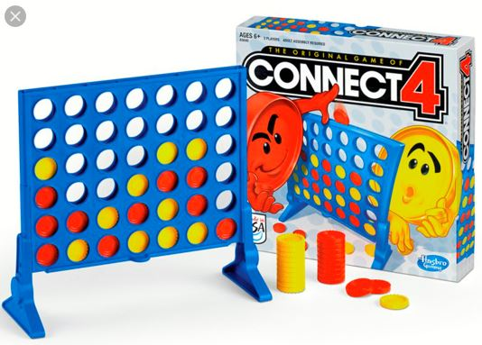
Table of Contents
Our Incentive (Introduction)
Code Design Process
Class Relationships
What We have Learned
Milestones
Installation
Gameplay
Conclusion
Call to Action

Slide 3
Our Incentive
We set out to achieve a new goal: creating an actual connect four game.

Slide 4
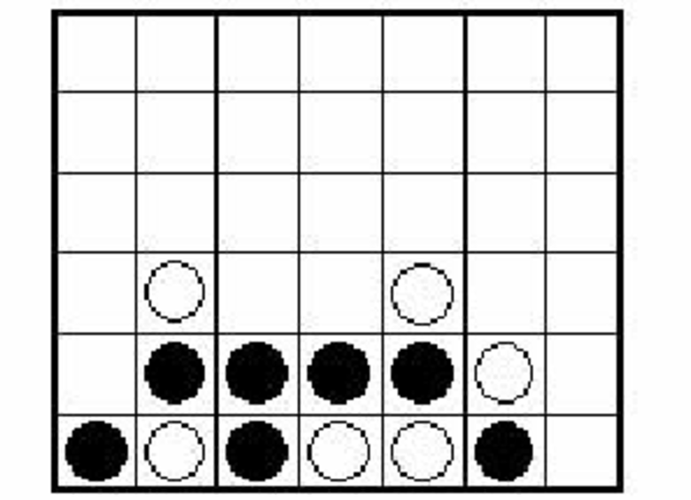
We all know the rules. We played this game as kids, but how do we actually code it out? How do we arrange the visuals and design the code? We pick up on all the little details that matter to deliver this experience.
GUI
Picking column
BACKEND
Inform player:
Who’s Turn: ___
score: ___
score: ___
Who won: ___
No floating
Check direction for win

Slide 5

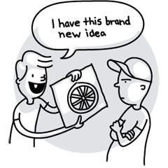
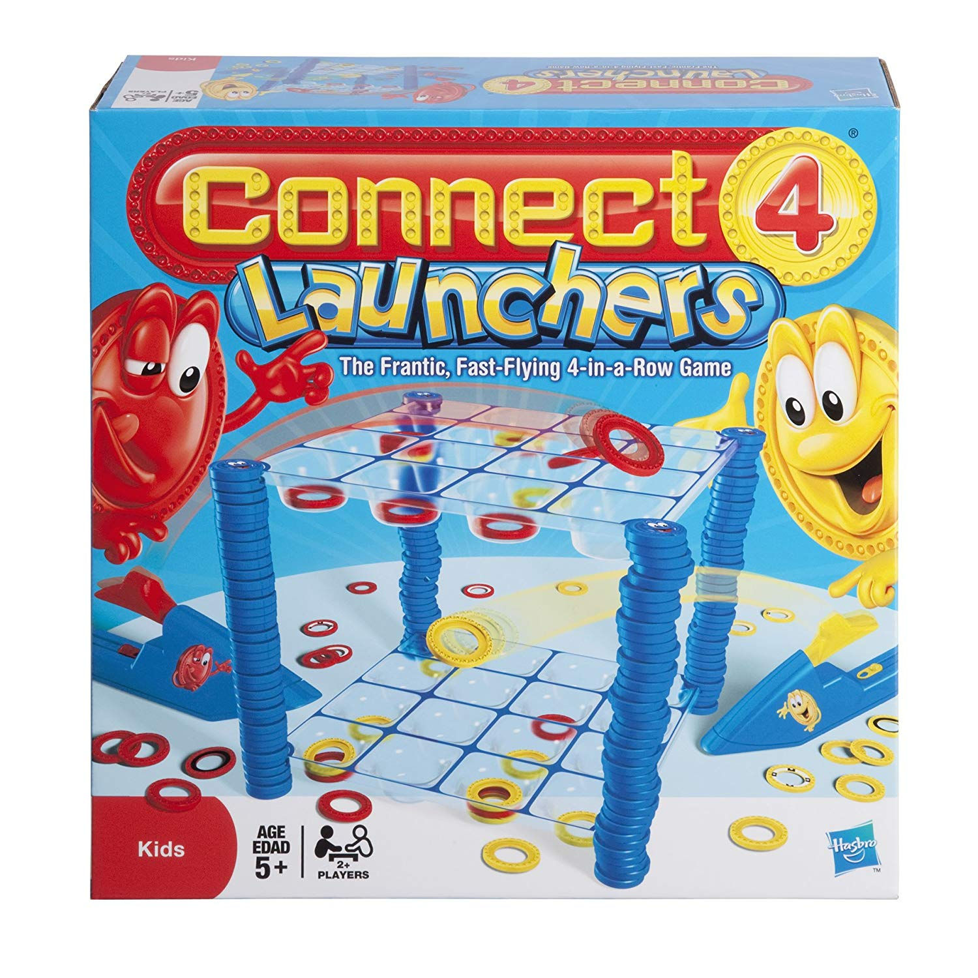
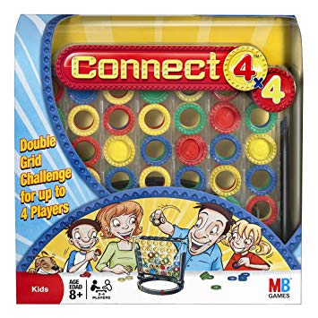
There have been many interpretations of Connect Four. We made our game to be simplest version to keep within scope. So, its not going to be anything new.

Slide 6



It was a new challenge that we had to overcome, starting with our basic knowledge of python and the game rules.

Slide 7
Code Design Process
Our code design has had a massive overhaul compared to the code design in our previous presentation.

Slide 8
Ex.
<<class>>
ConnectFourBoard
string: P1
string: P2
String: EMPTY
Int: dim_col
Int: dim_row
String: turn
List[List[string]]: board
<<class>>
ConnectFourBoard
string: P1
string: P2
String: EMPTY
Int: dim_col
Int: dim_row
List[List[string]]: board
+ drop(int col): bool
+ other_player(): str
+ whos_turn(): str
+ switch_turn(): None
+ check_for_win(): bool
+ check_win_at_position(row: int, col: int): bool
+ alternation(x: int, y: int, dx: int, dy: int): bool
+ valid_move(col: int, row: int): bool
+ is_game_over(): bool
+ get_drop_loc(col: int): int
+ move_left(): None
+ move_right(): None
+ drop(): None
+ whos_turn(): str
+ check_for_win(): bool
+ valid_move(): bool

Slide 9
We had learned to adapt the “Agile” methodology of coding for our project.
We had been able to progressively adapt slight changes to our class designs and relationships.
This allowed for us to revisit and improve our implementations.

Slide 10
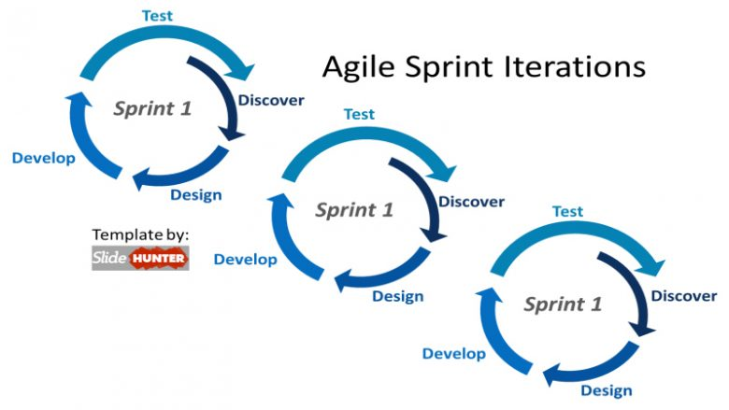

Slide 11
Installation

Slide 12
No installation required
MacOS/Linux user:
Download ConnectFour.app
Windows user:
Download ConnectFour.exe
No Python, Pygame etc needed.
Download Link:
https://github.com/NMZ0429/Connect-Four-Project/archive/master.zip

Slide 13
Game Play

Slide 14
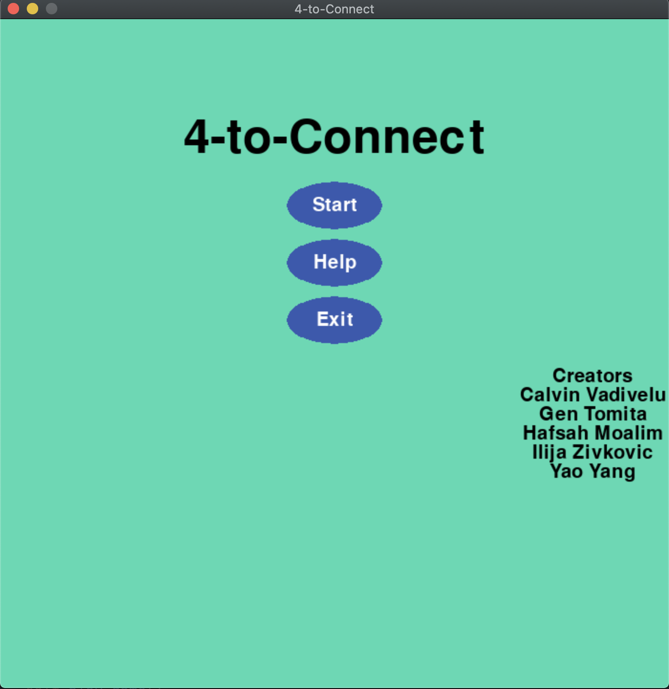
Start Menu
Three options
Play the game
See how to play
Quit the game

Slide 15
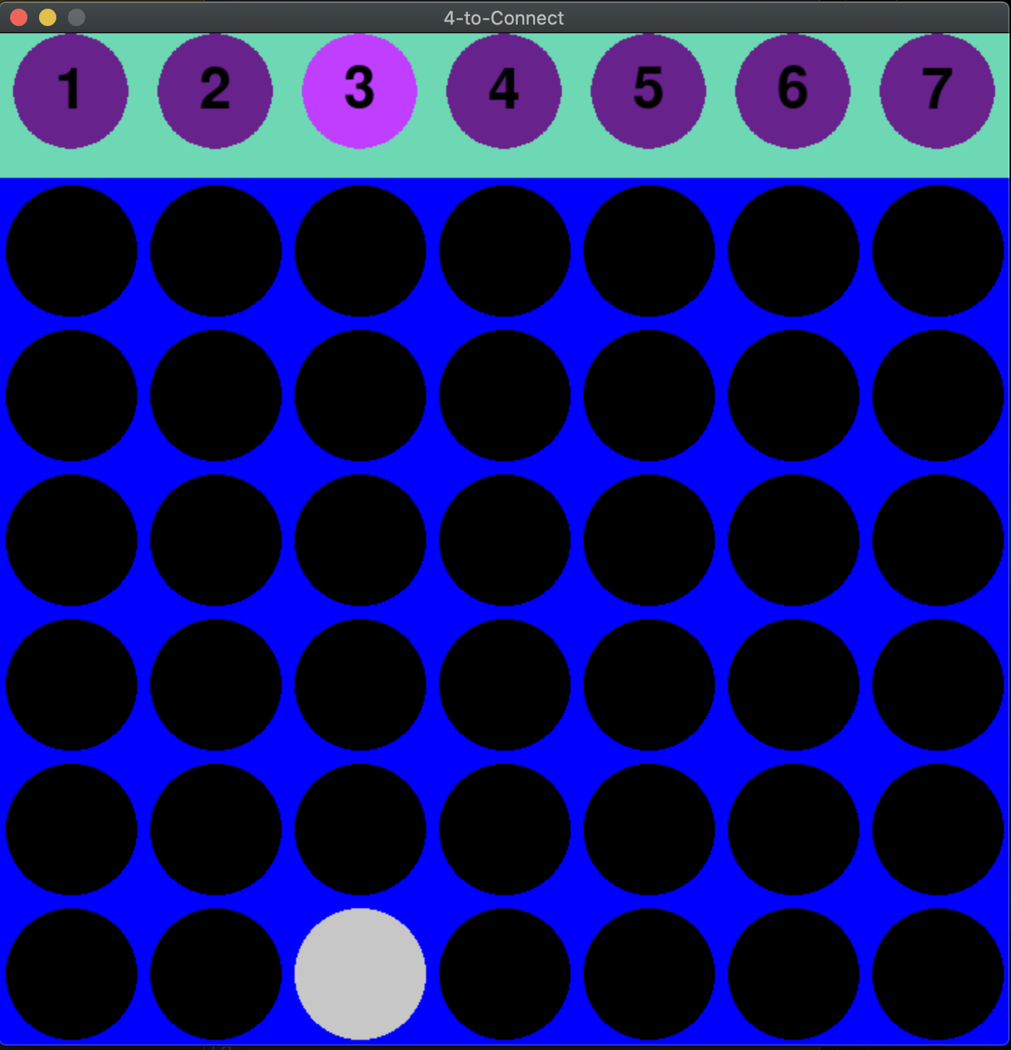
How to play
Click a column to put your stone
GUI highlight which column you are on
Any place within the column is clickable

Slide 16
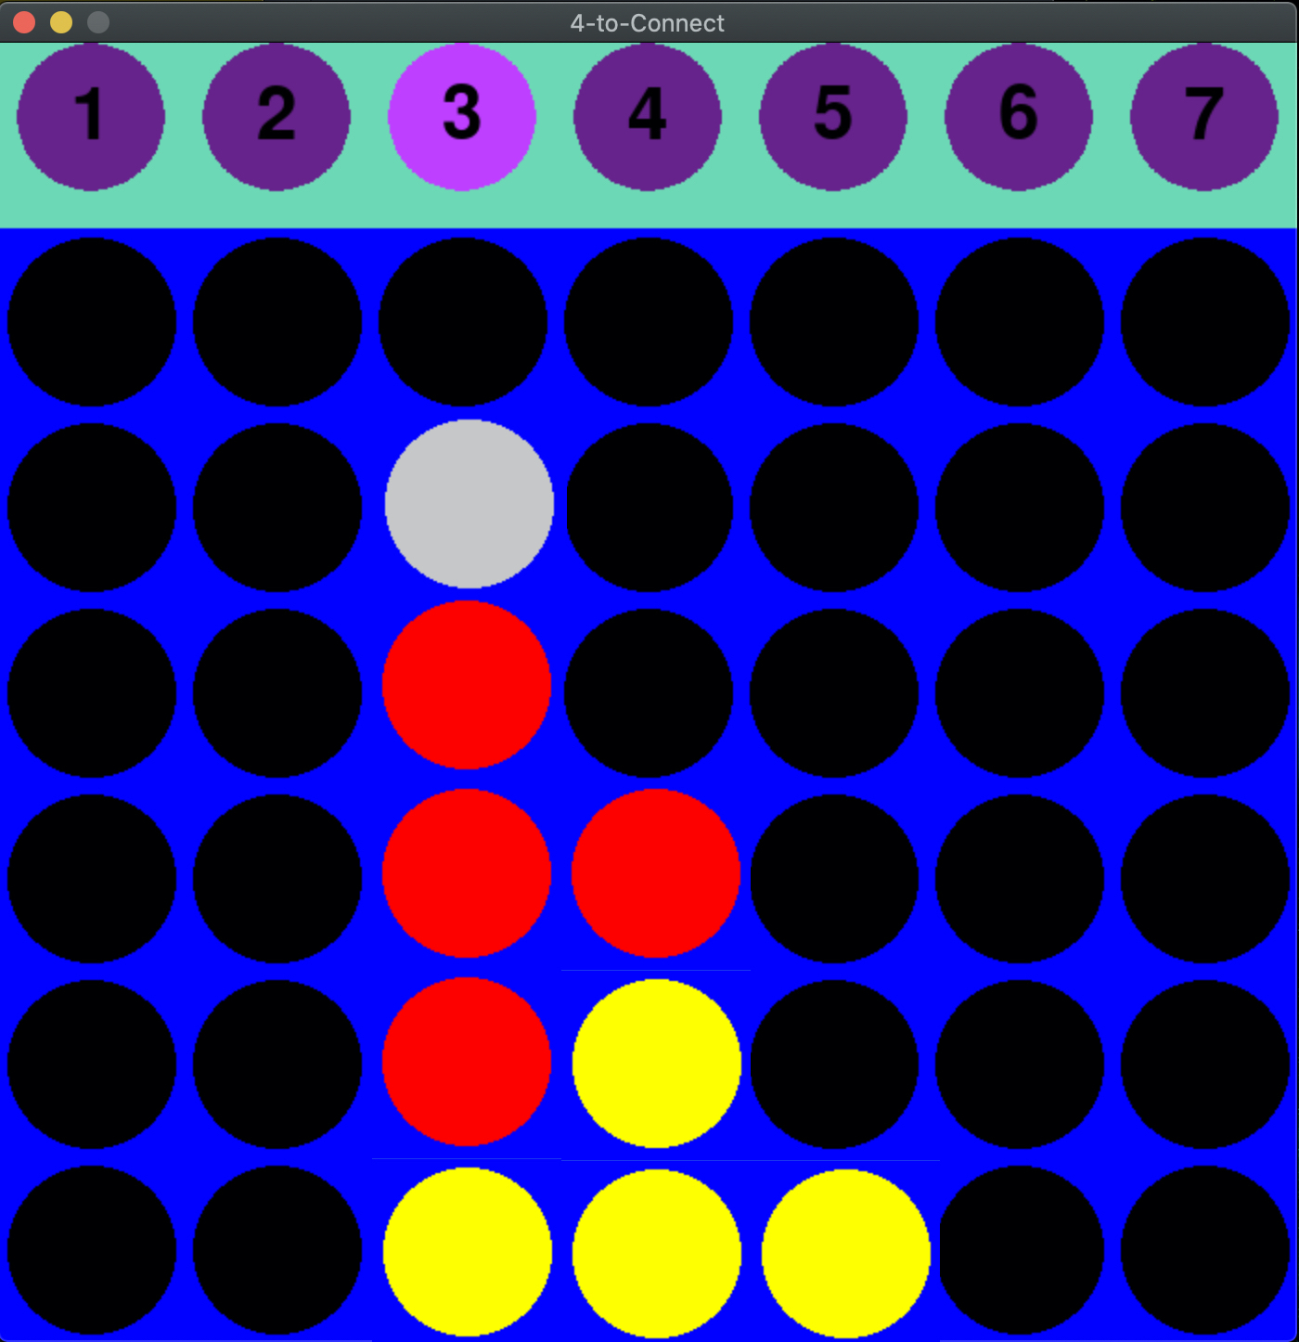
Turn change
Player’s turn is automatically switched after each click
Red stone: Player 1
Yellow stone: Player 2

Slide 17
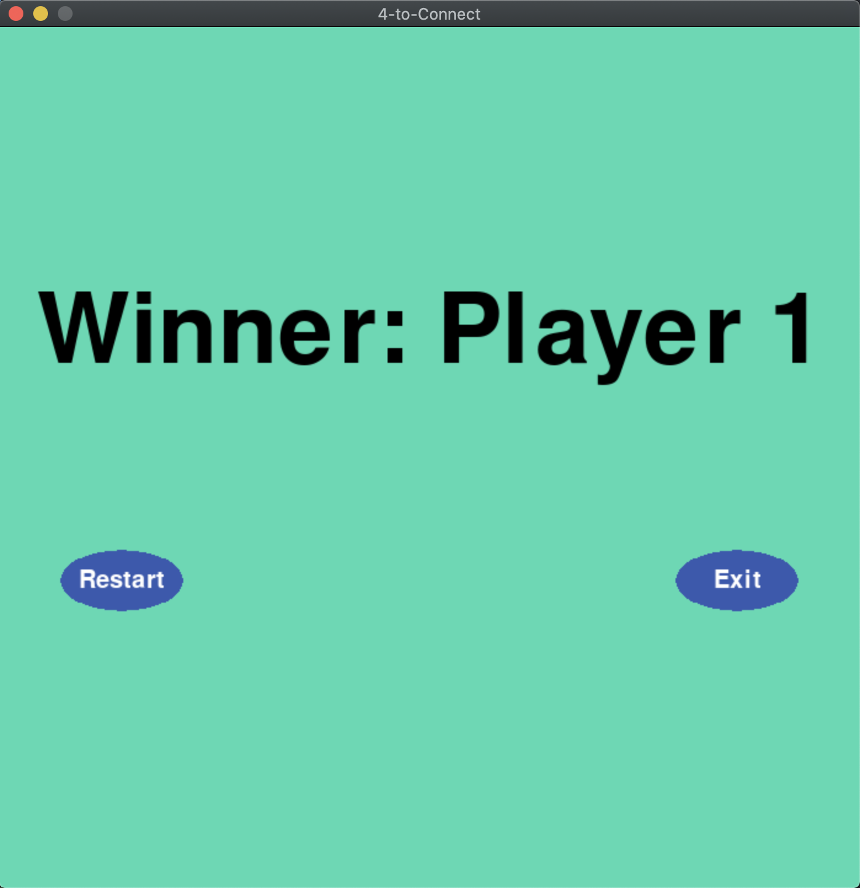
End view
Game will end when 4 stones are on a line
Then the game will show end view
You can play new match or quit

Slide 18
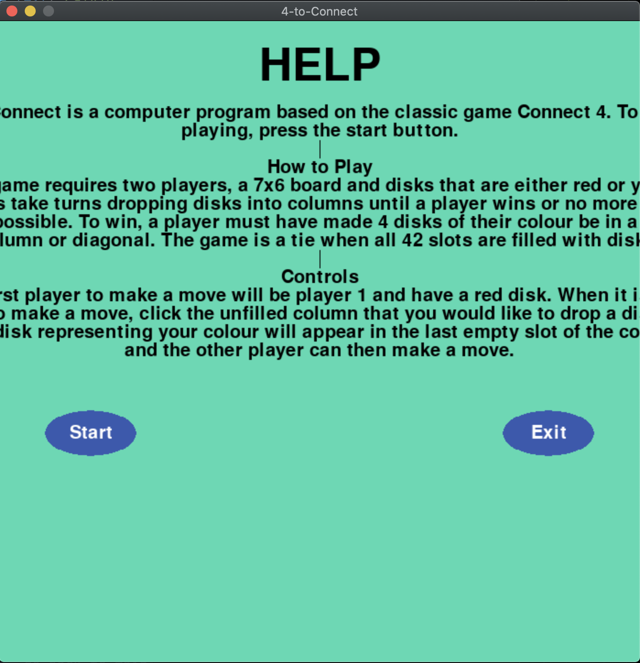
Help page
Click ”Help” in start menu
Rules and how to play

Slide 19
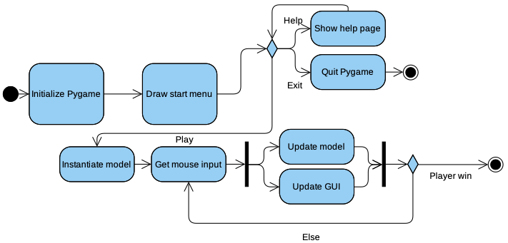
Activity diagram

Slide 20
What we have learned from project?

Slide 21

Meet in person
Scheduling meeting can be hard, but it is necessary.

Slide 22

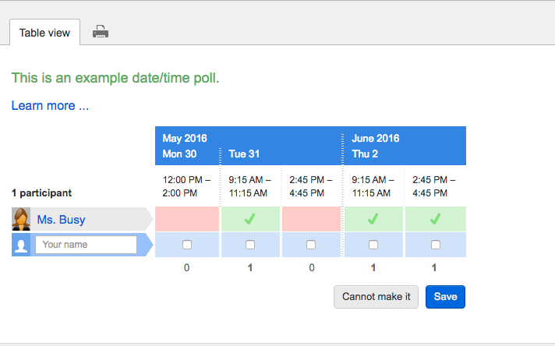
How to do better?
Using tools.

Slide 23

Milestones are important.

Slide 24
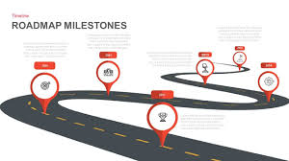
Strictly follow the milestones.

Slide 25
Conclusion

Slide 26
We set out to learn game implementation with our own Connect Four using python and pygame coding

